Slide 1

Focal Loss for Dense Object Detection
Tsung-Yi Lin Priya Goyal Ross Girshick Kaiming He Piotr Dollar
主讲人：韩一辉

Slide 2
能否提出一个 single, unified network，兼顾one-stage的速度和two-stage的精度？
Notes:
林宗毅 FPN作者

Slide 3
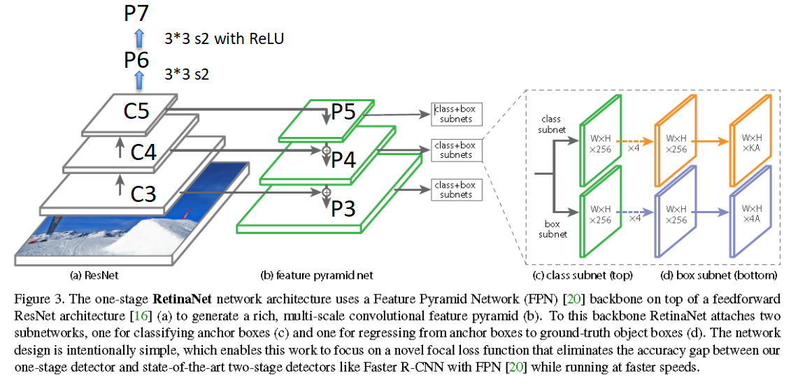
网络结构：ResNet+FPN+two subnetworks(classification+regression)
特点：
1、特征提取能力强
2、特征融合
3、两个特定任务
Notes:
1、不用P2，因为计算原因
2、p6通过卷积而不是下采样
3、p7提高大目标的检测
这些细微的改变在保持精度情况下提高了速度

Slide 4
训练：在初始化和训练策略没有调整的情况下使用标准的交叉熵
fails quickly，训练时网络发散

Slide 5
why？
新发现：Under such an initialization, in the presence of class imbalance,the loss due to the frequent class can dominate total loss and cause instability in early training
解决：introduce the concept of a “prior” for the value of p estimated by the model for the rare class (foreground) at the start of training.
All new conv layers except the final one in the RetinaNet subnets are initialized with bias b = 0 and a Gaussian weight fill with sigma = 0.01. For the final conv layer of the classification subnet, we set the bias initialization to b = -log((1-π)/π), where π specifies that at the start of training every anchor should be labeled as foreground with confidence of 0.01.
结果：Training RetinaNet with ResNet-50 and this initialization already yields a respectable AP of 30.2 on COCO.
Notes:
1、在这样的初始化条件下，存在类别不平衡，在早期训练时，背景类的loss多到可以控制总的loss，导致不稳定
2、对p值引入一个先验的概念，在开始训练时对p做一个估计，对分类网络最后一层进行一个特殊的初始化，其余层正常初始化

Slide 6
一个重大的发现：class imbalance
why call RantinaNet？
Dense！！！
We sweep over the number of scale and aspect ratio anchors used at each spatial position and each pyramid level in FPN

Slide 7
一个重大的发现：class imbalance
原因：
input image size：600 pixels
feature map：p3 p4 p5 p6 p7
anchor：第一次：a single square anchor，12 anchors per location spanning 4 sub-octave scales and 3 aspect ratios [0.5, 1, 2] ，AP (30.3）
之后：3 scales and 3 aspect ratios per location ，improved by nearly 4 points (to 34.0)
结果：candidate object locations about 100K that densely cover spatial positions,scales, and aspect ratios.

Slide 8
why two-stage not？
address class imbalance through two mechanisms:
(1) a two-stage cascade
例如：
R-CNN：Selective Search,2000个候选框划分正负样本
faster R-CNN:RPN 2000 proposals ，控制正负比1:3
(2) biased minibatch sampling
例如：
OHEM：将原图的所有proposals扔到RoINet1，计算它们的loss，根据loss从高到低排序，以及利用NMS，来选出前K个proposals
注意：模型的机制决定其优劣势
Notes:
1、两阶段串联的模型，在two-stage检测中，目标候选机制将可能的目标定位从无穷降到了一两千，更重要的是，他选择的候选框不是随机的，而是跟真实的目标定位有关，这就去除了大量的easy negative样本
2、有偏的抽样，在训练第二阶段时，典型的用有偏的抽样去构建minibatch，例如包含一个1:3的正负样本比

Slide 9
一个重大的发现：class imbalance
影响：two problems
(1) training is inefficient as most locations are easy negatives that contribute no useful learning signal;
(2) en masse,the easy negatives can overwhelm training and lead to degenerate models
Notes:
1、训练无效率或徒劳，因为大多数定位是easy negatives，他们对学习没有用
2、easy negatives会控制训练，导致模型退化

Slide 10
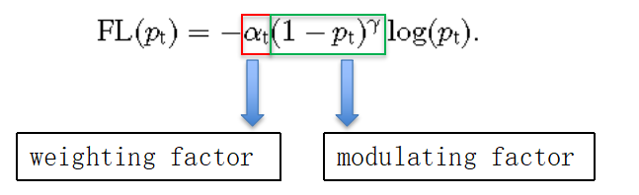
Focal Loss
1、权重因子用于调节positive和negative的比例

Slide 11
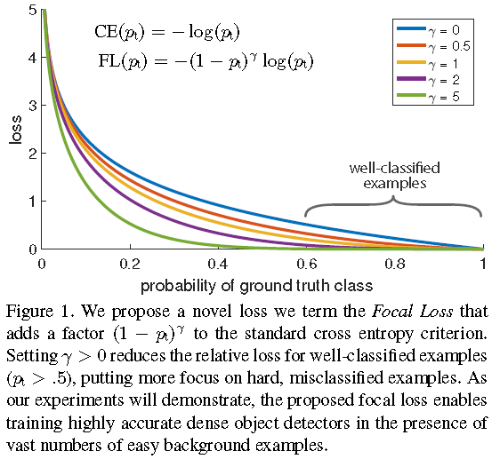
Focal Loss
2、调整因子抑制easy example

Slide 12
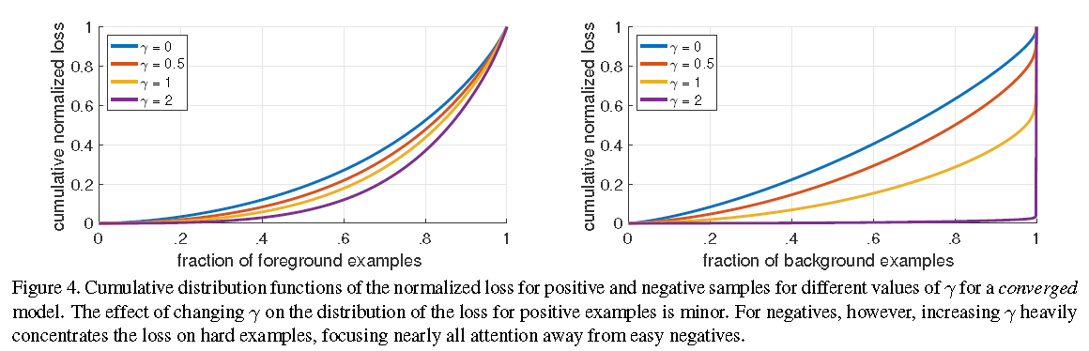
Focal Loss
As can be seen, FL can effectively discount the effect of easy negatives,focusing all attention on the hard negative examples
原因：Easily classified negatives comprise the majority of the loss and dominate the gradient
Notes:
归一化loss累计分布图
1、FL有效地降低了easy negatives的影响，将焦点集中在hard negative 样本上
2、原因：easy negative样本组成了loss中大部分，支配了梯度

Slide 13
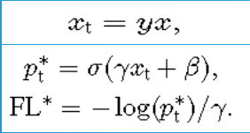
Focal Loss
the exact form of the focal loss is not crucial
two properties of the focal loss:
(1) When an example is misclassified and pt is small, the modulating factor is near 1 and the loss is unaffected. As pt→1, the factor goes to 0 and the loss for well-classified examples is down-weighted.
(2) The focusing parameter smoothly adjusts the rate at which easy examples are downweighted.
Notes:
FL的具体形式不重要
具备两个性质：
1、当样本被分错类，pt小，调节因子接近1，不影响loss，随着pt接近1，因子趋于0，下调分类好的样本的loss
2、这个参数可以光滑的调整easy examples权重下滑的比率

Slide 14
模型细节：
1、FPN backbone：
While many design choices are not crucial, we emphasize the use of the FPN backbone is; preliminary experiments using features from only the final ResNet layer yielded low AP.
2、Anchors：
The anchors have areas of 32*32 to 512*512 on pyramid levels P3 to P7;
three aspect ratios {1:2; 1:1, 2:1};
anchors of sizes {2^0,2^(1/3), 2^(2/3)}of the original set of 3 aspect ratio anchors.
In total there are A = 9 anchors per level and across levels they cover the scale range 32-813 pixels with respect to the network‘s input image.
intersection-over-union (IoU) threshold:
0.5:ground-truth object boxes;
[0, 0.4):background;
[0.4, 0.5):ignored during training.

Slide 15
模型细节：
3、Classification Subnet and Box Regression Subnet：
相同结构，不共享参数；对FPN中每个层共享分类和回归网络
4、Inference：
at most 1k top-scoring predictions per FPN level, after thresholding
detector confidence at 0.05. The top predictions from all levels are merged and non-maximum suppression with a threshold of 0.5 is applied to yield the final detections.
5、Focal loss：
normalized by the number of anchors assigned to a ground-truth box
6、 Initialization：
不同的初始化策略

Slide 16
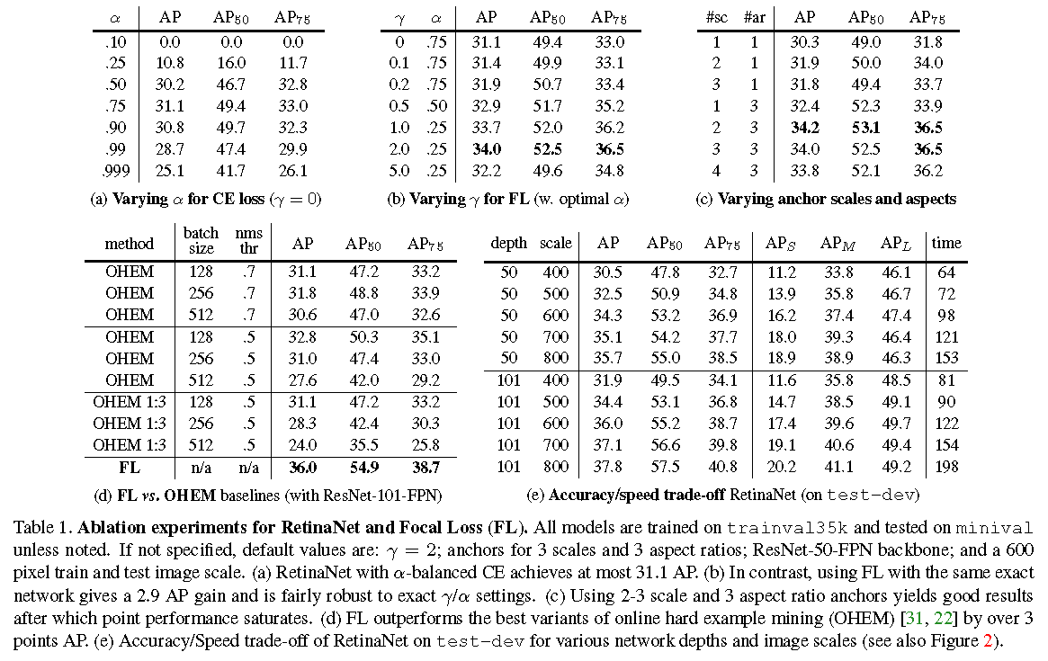
Experiments
1、lower α are selected for higher γ(as easy negatives are downweighted，less emphasis needs to be placed on the positives).
α =0.25，γ=2时最优
2、beyond 6-9 anchors did not shown further gains.
3、This is a gap of 3.2 AP, showing FL is more effective than OHEM for training dense detectors.

Slide 17
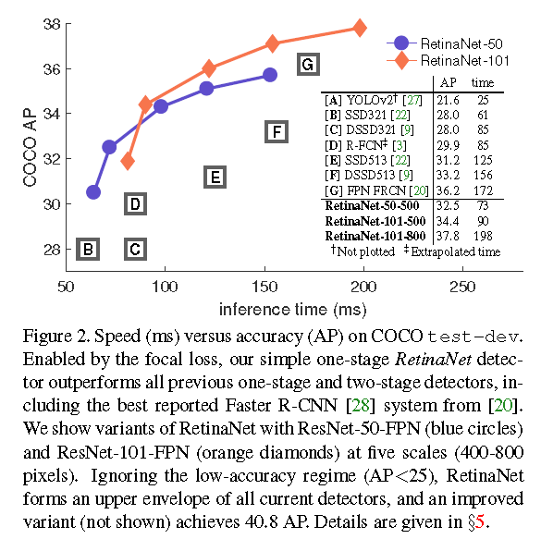
Experiments
Larger backbone networks yield higher accuracy, but also slower inference speeds. Likewise for input image scale.

Slide 18
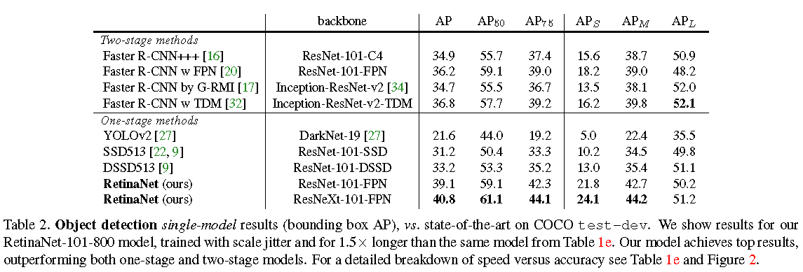
Experiments

Slide 19
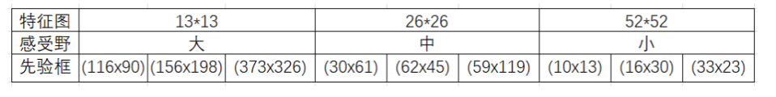
思考？
为什么YOLO V3使用Focal loss无效？
原文作者：
it has separate objectness predictions and conditional class predictions.
可能原因：
1、特征图的大小与正负样本比
2、anchor的设置
proposal box：（52×52+26×26+13×13）×3=10647个
Notes:
1、yolo的三个特征图的边比ratinanet的大，约50%
2、每个位置的anchor数量太多

